Slide 1
Beginning Arduino
Hoosier Recreation 2016

Slide 2
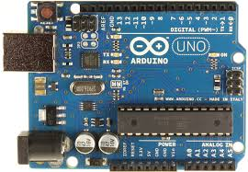
What is an Arduino?
Open source hardware and software platform based on the Atmel ATMega microprocessor
Embraced by hobbyists, artists, to scientists
Gives and easy way for direct hardware control of sensors, motors, LEDs, sounders. Unlimited possibilities!
Developed to provide a cheap and easy way to introduce programming and hardware design to the masses.

Slide 3
Arduino Uno Specs
Microcontroller | ATmega328P
Operating Voltage | 5V
Input Voltage (recommended) | 7-12V
Input Voltage (limit) | 6-20V
Digital I/O Pins | 14 (of which 6 provide PWM output)
PWM Digital I/O Pins | 6
Analog Input Pins | 6
DC Current per I/O Pin | 20 mA
DC Current for 3.3V Pin | 50 mA
Flash Memory | 32 KB (ATmega328P) of which 0.5 KB used by bootloader
SRAM | 2 KB (ATmega328P)
EEPROM | 1 KB (ATmega328P)
Clock Speed | 16 MHz
Length | 68.6 mm
Width | 53.4 mm
Weight | 25 g

Slide 4
Types of Arduinos
Uno (Standard base unit)
Nano, Pro mini –Small size, reduced capabilities
Mega – Larger, faster, more input/output pins
Yun, Leonardo – Same size as uno, Linux based micro computer
Lillypad
Due

Slide 5
Arduino Software
Based on the Processing language
Download from Arduino.cc
Free
Programs are called Sketches
Uses a subset of C++ for coding
Each Arduino has a bootloader so the computer can communicate and program the board directly through the usb ports.

Slide 6
Getting Started Programming
Install driver for CH340/CH341 http://www.microcontrols.org/arduino-uno-clone-ch340-ch341-chipset-usb-drivers/
Open the software
File – Examples
Tools – Board – Select Arduino/Genuino Uno

Slide 7
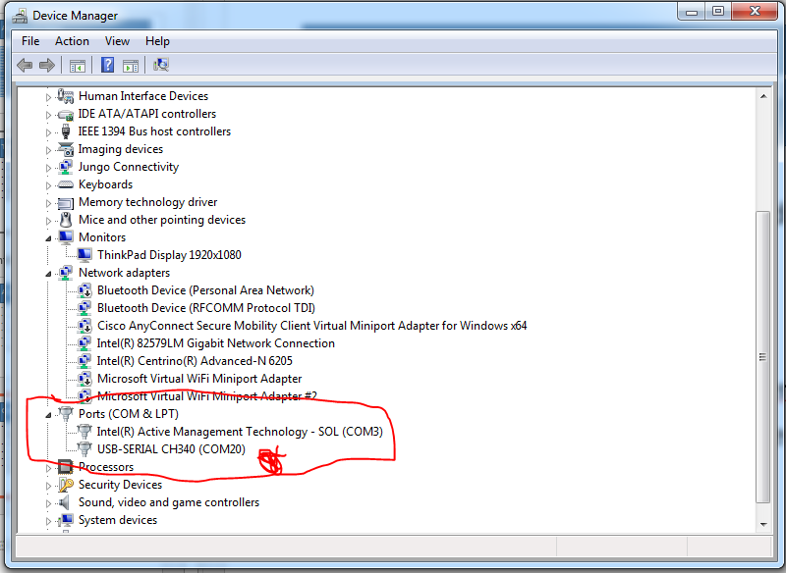
Open Device Manager, Ports
Plug 1 board into the USB hub and turn on. Will see new entry under ports
Tools – Port – pick the port number from Device Manager that matches.
Repeat for other board

Slide 8
Don’t Blink – You’re first program
Go to File – Examples – 01.Basics – Blink
Press Checkmark icon – Should compile with no problems
Insert LED into pin headers marked 13 and ground
Click Upload Arrow – Should load code to Arduino, watch RX,TX LEDs
Congrats! You LED is blinking.
You can only do this with Pin 13. All others will need a resistor or the LED could be destroyed.

Slide 9
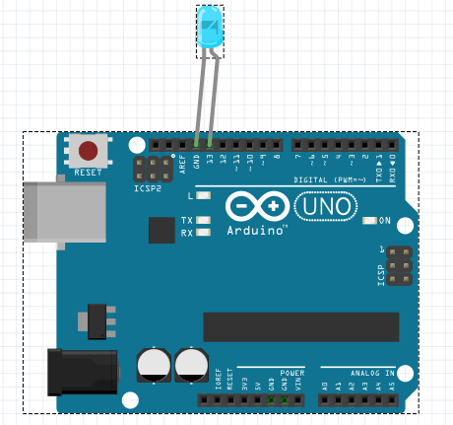

Slide 10
Build the breadboard circuit
Insert switch over rail gap in second rail
Add the 10K ohm resistor between pushbutton and ground (black) rail
Add LED 1 and Led 2
Add 220 ohm resistors from anode to adjacent rail
Add jumper wires from LED cathode to ground rail
Orange jumper wire from 12 to first LED resistor rail
Brown jumper wire from 11 to second resistor rail

Slide 11
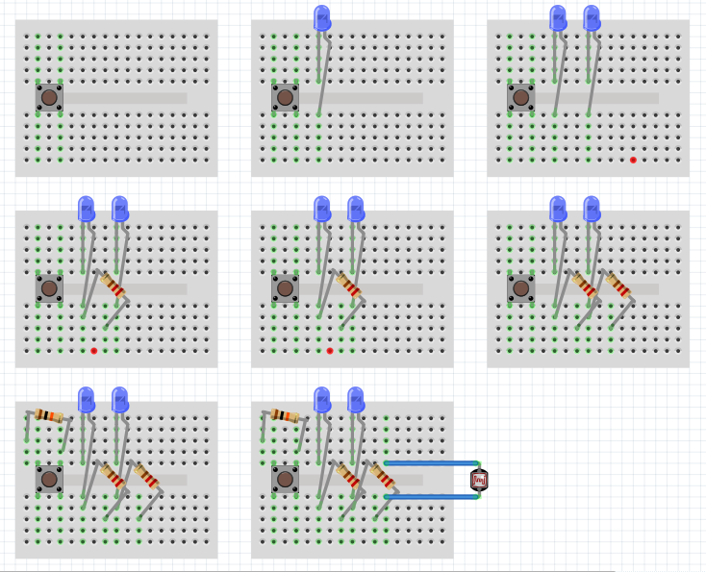

Slide 12
Now make them both blink
Digital outputs
Variables
Byte, int, float, char, double, long
Setup
Loop
Delay

Slide 13
Digital Outputs
14 digital pins
In addition, some pins have specialized functions:
Serial: 0 (RX) and 1 (TX). Used to receive (RX) and transmit (TX) TTL serial data. These pins are connected to the corresponding pins of the ATmega8U2 USB-to-TTL Serial chip.
External Interrupts: 2 and 3. These pins can be configured to trigger an interrupt on a low value, a rising or falling edge, or a change in value. See the attachInterrupt() function for details.
PWM: 3, 5, 6, 9, 10, and 11. Provide 8-bit PWM output with the analogWrite() function.
SPI: 10 (SS), 11 (MOSI), 12 (MISO), 13 (SCK). These pins support SPI communication using the SPI library.
LED: 13. There is a built-in LED driven by digital pin 13. When the pin is HIGH value, the LED is on, when the pin is LOW, it's off.
TWI: A4 or SDA pin and A5 or SCL pin. Support TWI communication using the Wire library.
6 pwm PWM: 3, 5, 6, 9, 10, and 11. Provide 8-bit PWM output with the analogWrite() function.

Slide 14
Pulse Width Modulation (PWM) Fading
/* Fading This example shows how to fade an LED using the analogWrite() function. The circuit: * LED attached from digital pin 9 to ground. Created 1 Nov 2008 By David A. Mellis modified 30 Aug 2011 By Tom Igoe http://www.arduino.cc/en/Tutorial/Fading This example code is in the public domain. */ int ledPin = 9; // LED connected to digital pin 9 void setup() { // nothing happens in setup } void loop() { // fade in from min to max in increments of 5 points: for (int fadeValue = 0 ; fadeValue <= 255; fadeValue += 5) { // sets the value (range from 0 to 255): analogWrite(ledPin, fadeValue); // wait for 30 milliseconds to see the dimming effect delay(30); } // fade out from max to min in increments of 5 points: for (int fadeValue = 255 ; fadeValue >= 0; fadeValue -= 5) { // sets the value (range from 0 to 255): analogWrite(ledPin, fadeValue); // wait for 30 milliseconds to see the dimming effect delay(30); } }

Slide 15
Loop de Loop
For Loops: for (int x = 1, int x == 20, int++){do code}
Conditionals: = does not equal equals, == equals equals. = equals assignment
If statements : if (<variablename> Conditional <value>) {<code>}
if (LED1Pin == 11) {do some stuff}
Variable scope
//comments
/*Long comments*/

Slide 16
Analog Pins
The Uno has 6 analog inputs, labeled A0 through A5, each of which provide 10 bits of resolution (i.e. 1024 different values). By default they measure from ground to 5 volts, though is it possible to change the upper end of their range using the AREF pin and the analogReference() function. There are a couple of other pins on the board:
Analog Vs Digital

Slide 17
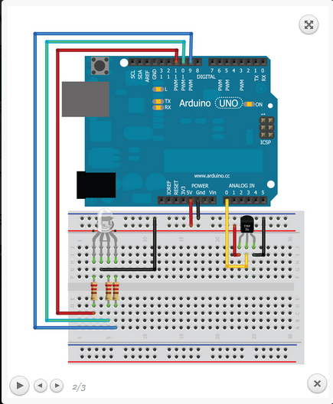
Reading Analog values
Potentiometer demo
Photo resistor

Slide 18
Shields
Motor
LCDs
Sensor
Proto
Ethernet
XBee

Slide 19
Get your motor running
DC Motor
Stepper motor
Servo (limited rotation)
Servo (continuous rotation)
Easiest to use shield
H Bridge
Transistor

Slide 20
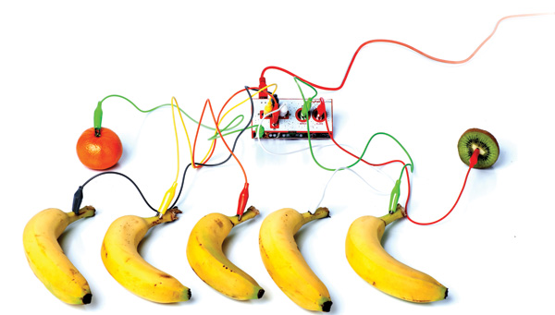
Making Sound
Sounders
Makey Makey
MIDI controllers
Stomp boxes/amps

Slide 21
Sensor
CENSORED
Many use 3 wire format
Accelerometers
Gyroscope
Proximity
Reed/magnetic
Heat/Humidity/Temperature

Slide 22
8x8 LED Matrix
This was adapted from here:
http://www.instructables.com/id/LED-Matrix-with-Arduino/
Controlling an LED matrix with a shift register chip MAX7219
LED Matrix Arduino Color of wire in picture VCC 5V Red GND GND Black DIN D12 Yellow CS D10 White CLK D11 Blue

Slide 23
